Slide 1
Easwari Engineering College (Autonomous)
Department of Computer Science and Engineering
LANE AND TRAFFIC SIGN DETECTION IN SELF DRIVING CARS USING DEEP LEARNING
SUPERVISOR:
MRS.B. PADMAVATHI
ASSISTANT PROFESSOR
STUDENT MEMBERS:
ANEESA K BANU (310618104011)
DHIVYA S (310618104027)
MUKESH KARTHIKEYAN S (310618104061)

Slide 2
Objective(s)
Easwari Engineering College (Autonomous)
Department of Computer Science and Engineering
To assist keeping a car in a particular lane in self-driving cars.
To detect lane lines in images using a fully connected CNN(Convolutional Neural Network).
To detect traffic signs along with lane detection in a self-driving car.
To distinguish different types of traffic sign for perception
using a CNN(Convolution Neural Network) .
23-June-22

Slide 3
Motivation
Easwari Engineering College (Autonomous)
Department of Computer Science and Engineering
Human beings, when fully attentive, do quite well at identifying lane line markings under most driving conditions.
Computers are not inherently good at doing the same.
Humans have a disadvantage of not always being attentive, while a computer is not subject to this downfall.
Training a computer to get as good as a human at detecting lane lines would let the computer take over this job from the human driver.
23-June-22

Slide 4
Literature Survey (1)
Easwari Engineering College (Autonomous)
Department of Computer Science and Engineering
Kanagaraj, N., Hicks, D., Goyal, A., Tiwari, S. and Singh, G.,2021,“Deep learning using computer vision in self driving cars for lane and traffic sign detection.”, International Journal of System Assurance Engineering and Management,12, pp.1-15.
Techniques/algorithms/Approaches used:
Convolution Neural Network (CNN) employing a Spatial Transformer Network (STN) for lane detection
a LeNet architecture with adam optimizer for traffic sign detection.
Achieved Result:
The LeNet-5 design was 97% accurate
The Feed Forward Neural Network was 94% accurate
Issues:
The dataset was imbalanced which led to wrong classification results

Slide 5
Literature Survey (2)
Easwari Engineering College (Autonomous)
Department of Computer Science and Engineering
Y.Liu, C. Shen, M. Qi and X. Fan, 2020,"SADANet: Integrating Scale
Aware and Domain Adaptive for Traffic Sign Detection," in IEEE Access,
vol. 8, pp. 77920-77933
Techniques/algorithms/Approaches used:
A scale-aware and domain adaptive network (SADANet) for traffic sign detection
Achieved Result
a precision value of 95.59%
Issues:
The method was not able to perform to its extent when there was an excessive discrepancy between the training and the test domain which makes it easy to have false detection.

Slide 6
Literature Survey(3)
Easwari Engineering College (Autonomous)
Department of Computer Science and Engineering
Y. Zhang, Z. Lu, D. Ma, J. -H. Xue and Q. Liao, 2021,"Ripple GAN: Lane
Line Detection With Ripple Lane Line Detection Network and Wasserstein
GAN," in IEEE Transactions on Intelligent Transportation Systems, vol.22,
no.3,pp.1532-1542.
Techniques/algorithms/Approaches used:
A multiscale region-based convolutional neural network (MR-CNN) on the TsinghuaTencent 100K dataset
Achieved Result:
RiLLD-Net can perform rapid detection with a recall of 95.13%.
Issues:
training of the network is unstable and the network is not easy to converge.

Slide 7
Issues in the Existing Systems
Easwari Engineering College (Autonomous)
Department of Computer Science and Engineering
In some models the dataset was not balanced and hence some classes had more images pertaining to them than the rest, this led to wrong classification outputs.
To tackle this issue we propose to use a balanced dataset.
One challenge for accurate lane detection is to deal with noise appearing in the input image, such as object shadows, brake marks, breaking lane lines.
To leverage the strength of color filters to find a rough localization of the lane marks and employ an optimized filter to screen out the embedded noises.

Slide 8
Proposed System
Easwari Engineering College (Autonomous)
Department of Computer Science and Engineering
To detect lane lines in images.
To build a deep learning model using fully connected CNN pre-trained model to detect lane in a image.
To implement a Convolutional Neural Network that can classify traffic signs present in the image into different categories.

Slide 9
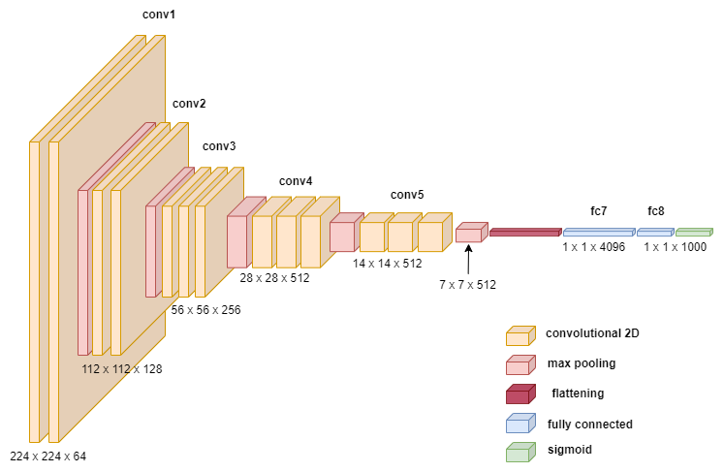
System Architecture VGG 16 CNN Model Architecture for Lane Detection
Easwari Engineering College (Autonomous)
Department of Computer Science and Engineering

Slide 10
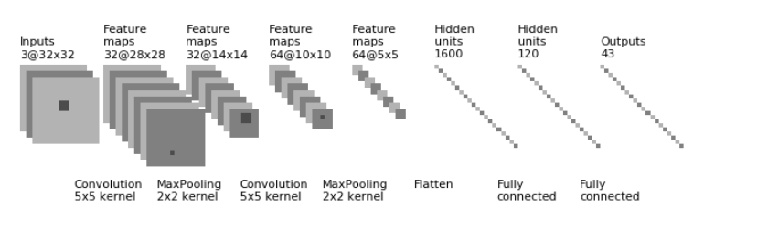
Easwari Engineering College (Autonomous)
Department of Computer Science and Engineering
System Architecture
CNN Model Architecture
for Traffic Sign Detection

Slide 11
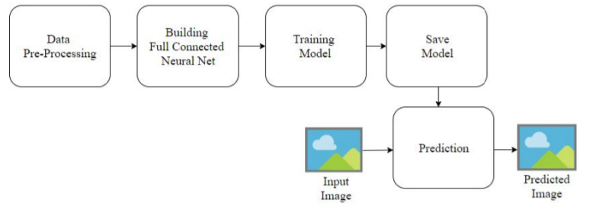
Functional Architecture
Easwari Engineering College (Autonomous)
Department of Computer Science and Engineering
Lane Detection

Slide 12
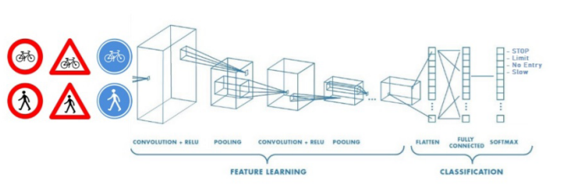
Functional Architecture Traffic Sign Detection
Easwari Engineering College (Autonomous)
Department of Computer Science and Engineering
Third Review

Slide 13
List of Modules
Easwari Engineering College (Autonomous)
Department of Computer Science and Engineering
1. Lane Detection using Fully connected CNN:
Data Pre-processing
Convolutional Neural Network
2. Traffic Sign Detection:
Data Pre-processing
Convolutional Neural Network

Slide 14
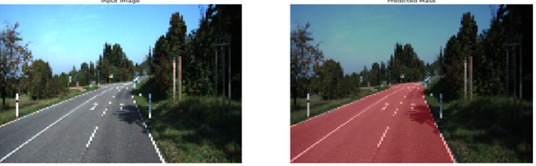
Input and Output of the System
Easwari Engineering College (Autonomous)
Department of Computer Science and Engineering
Lane detection:
The input is an image of the road to be traversed
The output is the image with the detected lane markings
INPUT IMAGE DETECTED LANE
Traffic sign detection:
The input is an image containing a traffic sign
The output is the corresponding class of the traffic sign

Slide 15
Lane Detection Module 1: Data Pre-Processing
Easwari Engineering College (Autonomous)
Department of Computer Science and Engineering
The dataset consists of road segmentation images from the KITTI Road/Lane Detection Evaluation 2013[10] dataset. The dataset consists of images with roads having marked and unmarked lanes.
The given data is split into testing and training sets. The images are loaded and the constants are initialized. The images are rescaled and pre-processing is done.

Slide 16
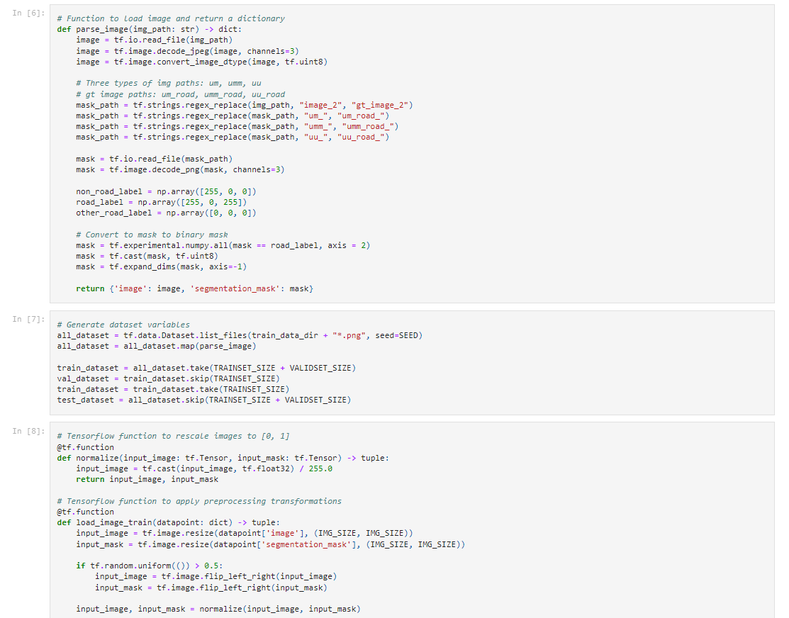
Easwari Engineering College (Autonomous)
Department of Computer Science and Engineering
Lane Detection
Module 1: Data Pre-Processing

Slide 17
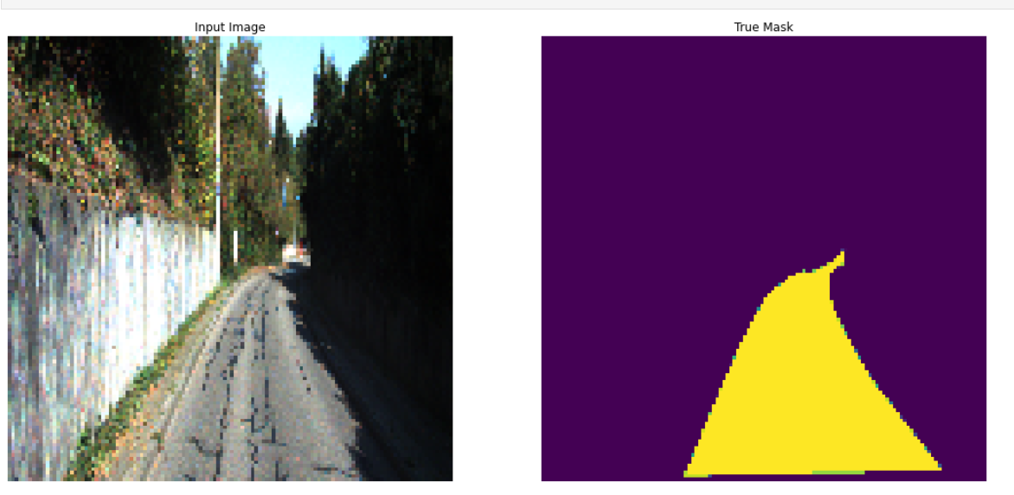
Lane Detection Result of Module 1: Data Pre-Processing
Easwari Engineering College (Autonomous)
Department of Computer Science and Engineering

Slide 18
Lane Detection Module 2: VGG 16 Convolutional Neural Network
Easwari Engineering College (Autonomous)
Department of Computer Science and Engineering
The VGG16 CNN network is initialized and the final 3 layers are encoded and up sampling is done to them.
This method is repeated and sigmoid activation function is used.
Adam optimizer is used. To optimise the results, binary cross-entropy was employed as a loss function.
The model is trained for 200 epochs.

Slide 19
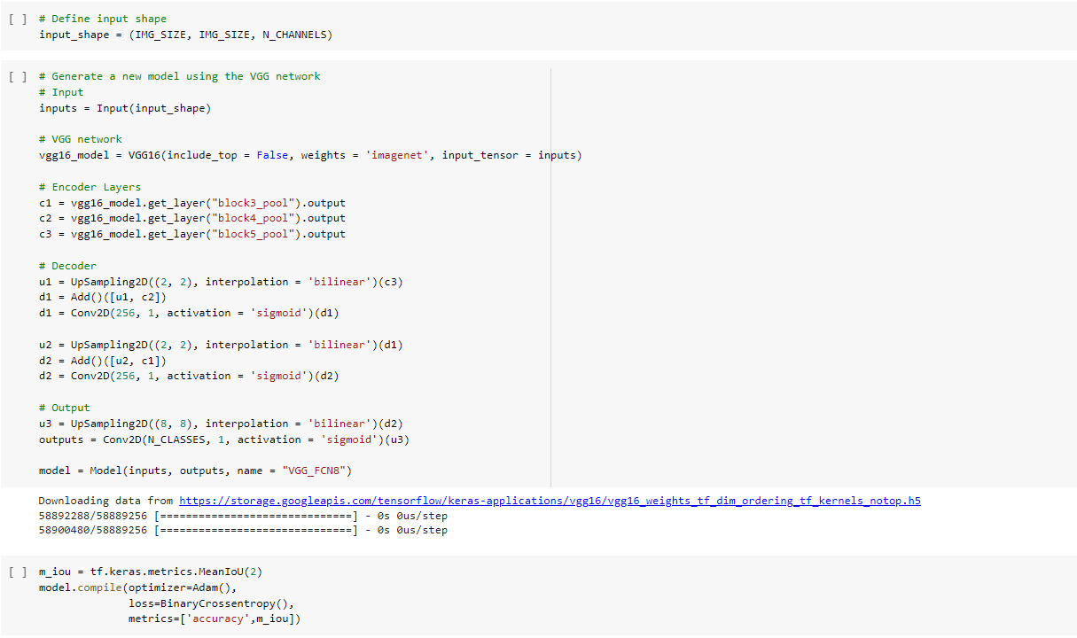
Lane Detection Module 2: VGG 16 Convolutional Neural Network
Easwari Engineering College (Autonomous)
Department of Computer Science and Engineering

Slide 20
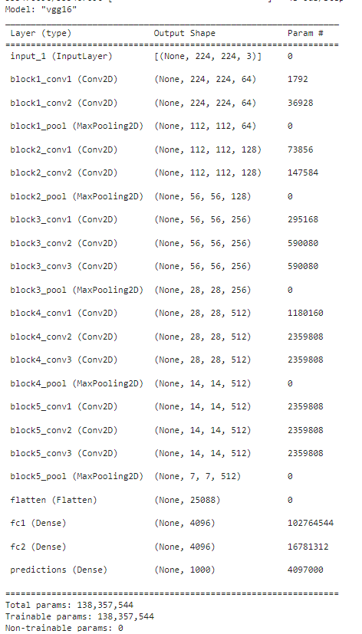
Lane Detection Result of Module 2 :Convolutional Neural Network
Easwari Engineering College (Autonomous)
Department of Computer Science and Engineering

Slide 21
Easwari Engineering College (Autonomous)
Department of Computer Science and Engineering
Traffic Sign Detection Module 1:Data collection and preprocessing
The dataset consists of traffic sign images from the German Traffic Sign Recognition Benchmark dataset.
It consists of 43 different classes of traffic signs used. It has more than 40,000 images. Some of the classes are ‘No Entry’, ‘Keep Left’ , ‘Stop’, ‘Yield’, ‘Turn right ahead’ etc.
All the images are stored in PPM format. The size of the dataset is 263 MB and all the images are annotated.
The dataset is split into training and test set and is used in a pickled format.
The dataset is pre-processed, augmented and normalized.
The training set consists of 34799 images and the testing set consists of 12630 images.

Slide 22
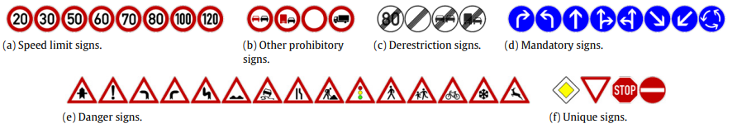
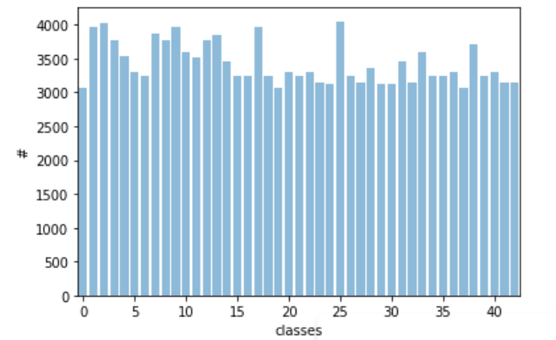
Traffic Sign Detection Result of Module 1:Data collection and preprocessing
Easwari Engineering College (Autonomous)
Department of Computer Science and Engineering

Slide 23
Easwari Engineering College (Autonomous)
Department of Computer Science and Engineering
Traffic Sign Detection Module 2: Convolutional Neural Network
The CNN model requires an image as the input.
The CNN model consists of 2 convolutional layers of kernel size 5x5, each followed by a max pooling layer of kernel size 2x2.
The convolutional layers produce feature maps which go to the max pooling layers. The max pooling layer is followed by one flattening layer and 2 fully connected layers.
RELU activation function is implemented after each convolutional layer. ADAM optimizer with a 0.001 learning rate was used and the CNN model was trained up to 15 epochs.
Categorical cross-entropy was used as a loss function to optimize results.

Slide 24
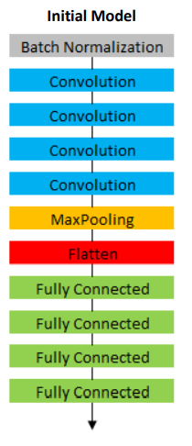
Easwari Engineering College (Autonomous)
Department of Computer Science and Engineering
Traffic Sign Detection Result of Module 2: Convolutional Neural Network

Slide 25
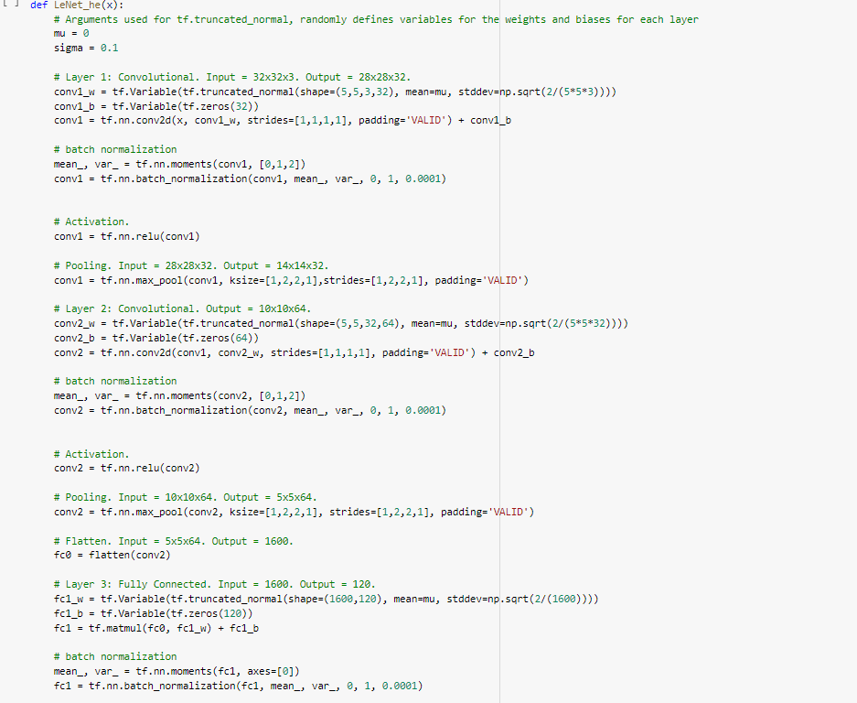
Traffic Sign Detection Result of Module 2:Convolutional Neural Network
Easwari Engineering College (Autonomous)
Department of Computer Science and Engineering

Slide 26
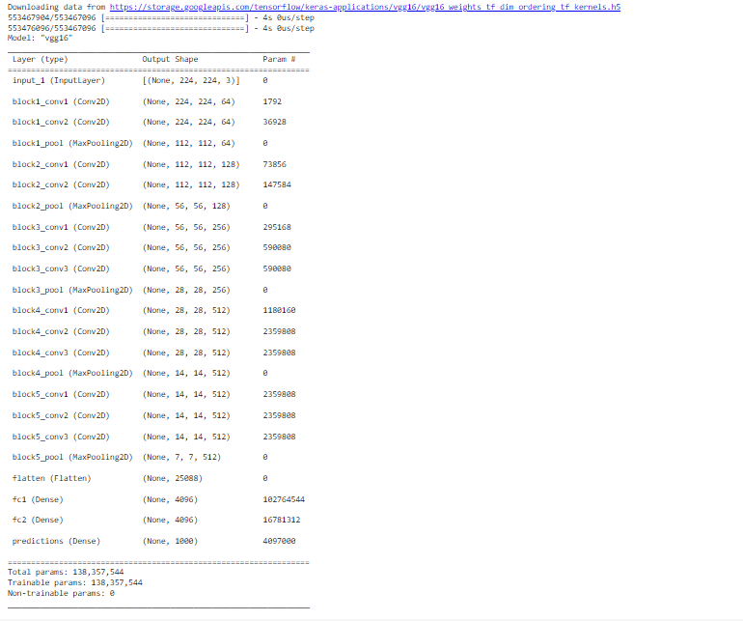
Easwari Engineering College (Autonomous)
Department of Computer Science and Engineering
Traffic Sign Detection Result of Module 2:Convolutional Neural Network

Slide 27
System Requirements
Easwari Engineering College (Autonomous)
Department of Computer Science and Engineering
OS: windows, Mac etc.
Development tool: Google collab / Jupyter Notebooks
Language: Python 3.6 and above
Dataset: The GTSRB dataset and the KITTI Road/Lane Detection Evaluation Dataset for lane detection
Testing: 20% of the KITTI Road/Lane Detection Evaluation 2013 Dataset and GTSRB dataset for testing

Slide 28
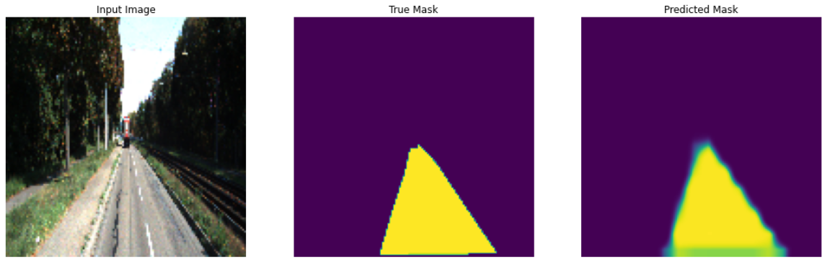
Easwari Engineering College (Autonomous)
Department of Computer Science and Engineering
Performance Analysis
LANE DETECTION IN SELF-DRIVING CARS
We calculate the loss, train accuracy and valid accuracy for the model. The loss function keeps decreasing with every epoch and the accuracy keeps increasing. After training the model for 200 epochs, the model gave an accuracy of about 98.58% and loss value of 0.0308.
Accuracy score: 0.98%
Sample prediction after 200 epochs

Slide 29
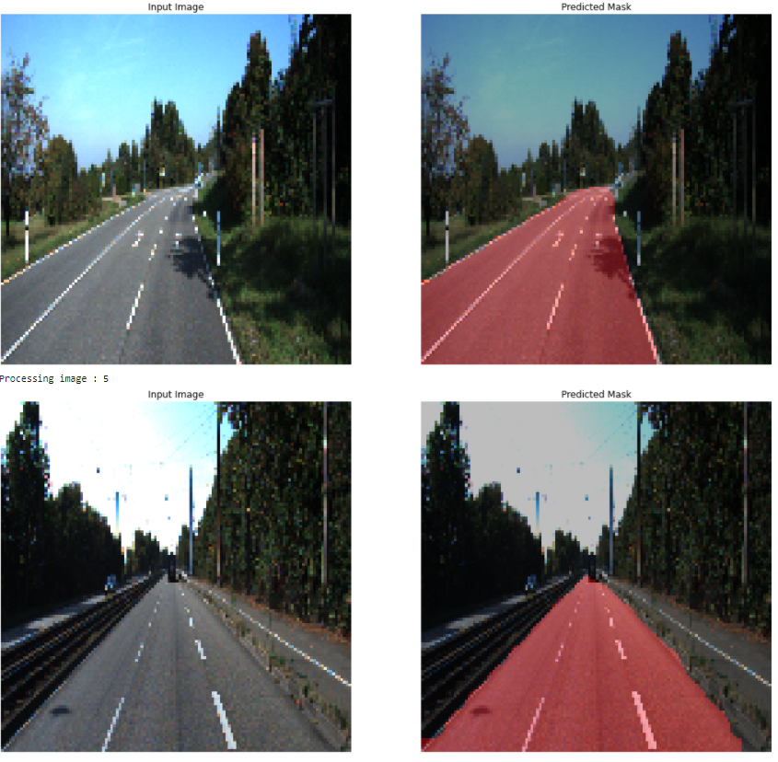
Easwari Engineering College (Autonomous)
Department of Computer Science and Engineering Performance Analysis
Sample predictions for lane segmentation

Slide 30
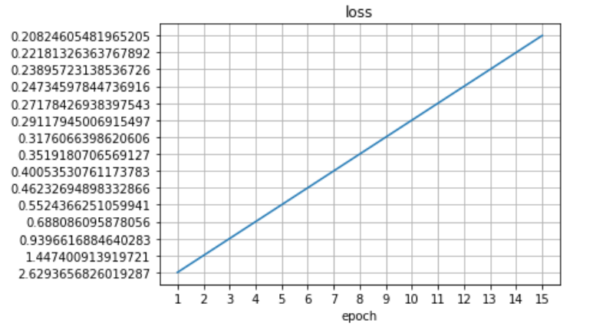
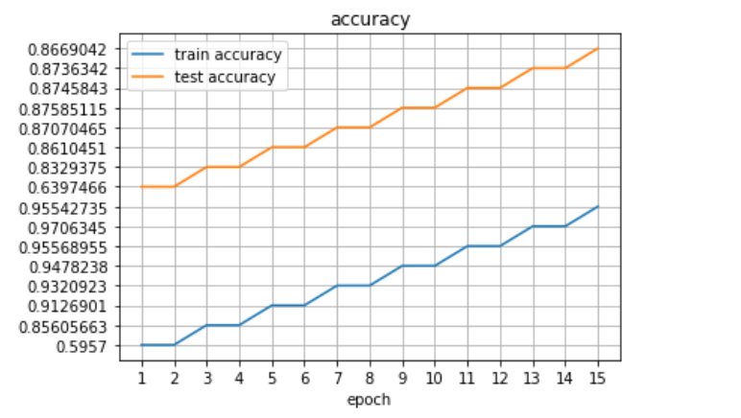
Easwari Engineering College (Autonomous)
Department of Computer Science and Engineering
Performance Analysis
TRAFFIC SIGN DETECTION IN SELF-DRIVING CARS
We calculate the loss, train accuracy and valid accuracy for the CNN model. The training set gave an accuracy of 95% at the end of the 15th epoch. The test dataset gave an accuracy of 86.7%.
model loss plot
model accuracy plot

Slide 31
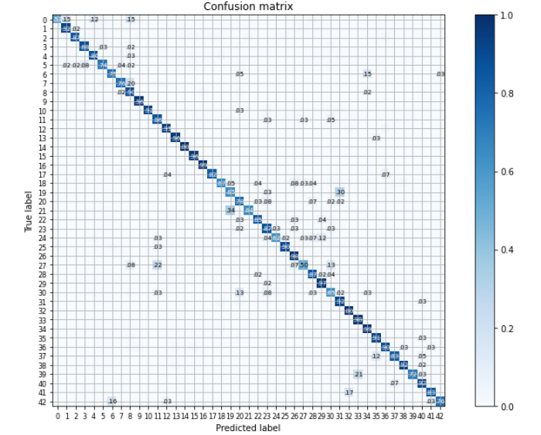
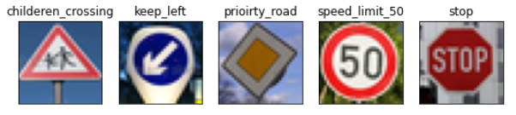
Easwari Engineering College (Autonomous)
Department of Computer Science and Engineering
Performance Analysis
Test images and their predicted classes
Confusion matrix for the CNN model for traffic sign detection

Slide 32
Easwari Engineering College (Autonomous)
Department of Computer Science and Engineering Applications
Real-time Computer Vision applications
Assists self-driving cars
Machine learning research

Slide 33
Conclusion & Future Work
Easwari Engineering College (Autonomous)
Department of Computer Science and Engineering
The model presented deep learning methodology for Lane segmentation and traffic sign detection in self-driving cars. Lane segmentation was performed on the KITTI Road/Lane Detection Evaluation 2013[10] dataset using a VGG16 CNN model. It performed well and segmented lanes correctly in most of the test images with an accuracy of about 98.58 %.
For traffic sign detection the German Traffic Sign Recognition Benchmark dataset[11] was used. A CNN model with ADAM optimizer was trained to give an accuracy of 95%.The proposed methodology gives greater accuracy when compared to models using other non-deep learning methodologies.
There are many more opportunities for further research in this area, particularly training a classifier with a larger dataset.
We’ll try looking for more data and better data augmentation techniques, as well as further improving the model.

Slide 34
References
Easwari Engineering College (Autonomous)
Department of Computer Science and Engineering
Kanagaraj, N., Hicks, D., Goyal, A., Tiwari, S. and Singh, G., (2021), ‘ Deep learning using computer vision in self driving cars for lane and traffic sign detection.’, International Journal of System Assurance Engineering and Management in Springer, 12, pp.1-15.
Y.Liu, C. Shen, M. Qi and X. Fan, 2020,"SADANet: Integrating Scale Aware and Domain Adaptive for Traffic Sign Detection," in IEEE Access,vol. 8, pp. 77920-77933.
Y. Zhang, Z. Lu, D. Ma, J. -H. Xue and Q. Liao, 2021,"Ripple GAN: Lane Line Detection With Ripple Lane Line Detection Network and Wasserstein GAN," in IEEE Transactions on Intelligent Transportation Systems, vol.22, no.3,pp.1532-1542.
Y. Zhang, J. Wang, X. Wang and J. M. Dolan, 2018, "Road-Segmentation-Based Curb Detection Method for Self-Driving via a 3D-LiDAR Sensor," in IEEE Transactions on Intelligent Transportation Systems, vol. 19, no. 12, pp. 3981-3991.

Slide 35
Easwari Engineering College (Autonomous)
Department of Computer Science and Engineering
References
P. Lu, C. Cui, S. Xu, H. Peng and F. Wang, 2021, "SUPER: A Novel Lane Detection System," in IEEE Transactions on Intelligent Vehicles, vol. 6, no. 3, pp. 583-593.
J. Zhang, Z. Xie, J. Sun, X. Zou and J. Wang, 2020,"A Cascaded R-CNN With Multiscale Attention and Imbalanced Samples for Traffic Sign Detection," in IEEE Access, vol. 8, pp. 29742-29754
Liu, Z., Shen, C., Qi, M. and Fan, X., 2020, “Sadanet: Integrating scale-aware and domain adaptive for traffic sign detection.”, IEEE Access, 8, pp.77920-77933.
Jin, Y., Fu, Y., Wang, W., Guo, J., Ren, C. and Xiang, X., 2020, “Multi-feature fusion and enhancement single shot detector for traffic sign recognition”, IEEE Access, 8, pp.38931-38940.

Slide 36
Thank You

